Slide 1

Efficient File Management System
Students’ Names
Aser Mohamed | 222102487 | Amina Elshabandy | 222100306
Basel Hammad | 222100363 | Sherif Farag | 222100822
Mostafa Ibrahim | 222101590 | Merna Muhammed | 222101717
Course Code: CSE || 233
Course Name : Operating Systems
Academic Year: 2024/2025
Semester: Fall

Slide 2

Contents
Introduction
Motivation
Project Flow chart
Project Code
Results
Conclusion

Slide 3
Introduction
This project demonstrates efficient file management techniques using Ubuntu Server , a popular Linux-based platform.
By integrating Bash scripts and C programming , it aims to automate and simplify file management tasks.
The goal is to improve data organization, access, and overall productivity within an operating system, catering to diverse needs on personal computers, network servers, or in the cloud.

Slide 4
Motivation
Automate Tasks: Streamline file management processes to reduce manual effort.
Improve Organization: Provide systematic ways to store, retrieve, and share files.
Enhance Accessibility: Ensure easy access to data on personal computers, network servers, or in the cloud.
Optimize Performance: Focus on reliability and speed to improve overall system performance.
Increase Productivity: Offer a seamless user experience that simplifies complex tasks and boosts productivity.

Slide 5
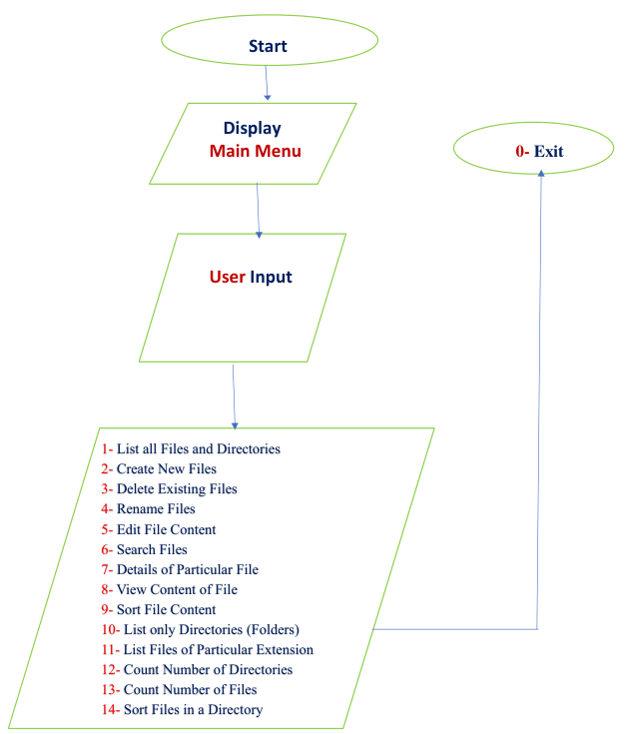
Flow chart

Slide 6
Project Code
#include <stdio.h>
int main(void) {
printf("=============================================================\n");
printf("----------------------- File Management Project -----------------------\n");
printf("=============================================================\n");
printf("Welcome, The Main Menu is given below:\n");
printf("1 - List all Files and Directories\n");
printf("2 - Create New Files\n");
printf("3 - Delete Existing Files\n");
printf("4 - Rename Files\n");
printf("5 - Edit File Content\n");
printf("6 - Search Files\n");
printf("7 - Details of Particular File\n");
printf("8 - View Content of File\n");
printf("9 - Sort File Content\n");
printf("10 - List only Directories (Folders)\n");
printf("11 - List Files of Particular Extension\n");
printf("12 - Count Number of Directories\n");
printf("13 - Count Number of Files\n");
printf("14 - Sort Files in a Directory\n");
printf("0 - Exit\n");
printf("\nWhat action you want to perform? Enter 1-14:\n");
return 0;
}

Slide 7
#!/bin/bash
i=0
while [ $i -lt 100 ]; do
gcc menu.c -o menu
./menu
read -p "Enter your choice: " opt1
case $opt1 in
1)
echo "Listing all files and directories..."
sleep 3
ls
;;
2)
echo "Create New Files here:"
echo "1 - .c"
echo "2 - .sh"
echo "3 - .txt"
read -p "Enter your choice (1-3): " filechoice
case $filechoice in
1)
read -p "Enter file name (without .c extension): " filename
touch "$filename.c"
echo "File $filename.c created successfully."
;;
2)
read -p "Enter file name (without .sh extension): " filename
touch "$filename.sh"
echo "File $filename.sh created successfully."
;;

Slide 8
3)
read -p "Enter file name (without .txt extension): " filename
touch "$filename.txt"
echo "File $filename.txt created successfully."
;;
*)
echo "Invalid input. Try again."
;;
esac
;;
3)
read -p "Enter the file name to delete (with extension): " delfile
if [ -f "$delfile" ]; then
rm "$delfile"
echo "File $delfile deleted successfully."
else
echo "File $delfile not found."
fi
;;
4)
read -p "Enter the old file name (with extension): " old
if [ -f "$old" ]; then
read -p "Enter the new file name (with extension): " new
mv "$old" "$new"
echo "File renamed to $new."
else
echo "File $old does not exist."
fi
;;

Slide 9
5)
read -p "Enter the file name to edit (with extension): " editfile
if [ -f "$editfile" ]; then
nano "$editfile"
else
echo "File $editfile does not exist."
fi
;;
6)
read -p "Enter the file name to search (with extension): " searchfile
find . -name "$searchfile" && echo "File $searchfile found." || echo "File $searchfile not found."
;;
7)
read -p "Enter the file name to view details (with extension): " detailfile
if [ -f "$detailfile" ]; then
stat "$detailfile"
else
echo "File $detailfile does not exist."
fi
;;
8)
read -p "Enter the file name to view content (with extension): " readfile
if [ -f "$readfile" ]; then
cat "$readfile"
else
echo "File $readfile does not exist."
fi
;;

Slide 10
9)
read -p "Enter the file name to sort content (with extension): " sortfile
if [ -f "$sortfile" ]; then
sort "$sortfile"
else
echo "File $sortfile does not exist."
fi
;;
10)
echo "Listing only directories..."
ls -d */
;;
11)
echo "1 - .c"
echo "2 - .sh"
echo "3 - .txt"
read -p "Enter your choice (1-3): " extopt
case $extopt in
1) ls *.c 2>/dev/null || echo "No .c files found." ;;
2) ls *.sh 2>/dev/null || echo "No .sh files found." ;;
3) ls *.txt 2>/dev/null || echo "No .txt files found." ;;
*) echo "Invalid input. Try again." ;;
esac
;;
12)
echo "Counting number of directories..."
echo $(find . -type d | wc -l) directories found.
;;

Slide 11
13)
echo "Counting number of files..."
echo $(find . -type f | wc -l) files found.
;;
14)
echo "Sorting files in the current directory..."
ls | sort
;;
0)
echo "Exiting the program. Goodbye!"
break
;;
*)
echo "Invalid choice. Try again."
;;
esac
i=$((i + 1))
done

Slide 12
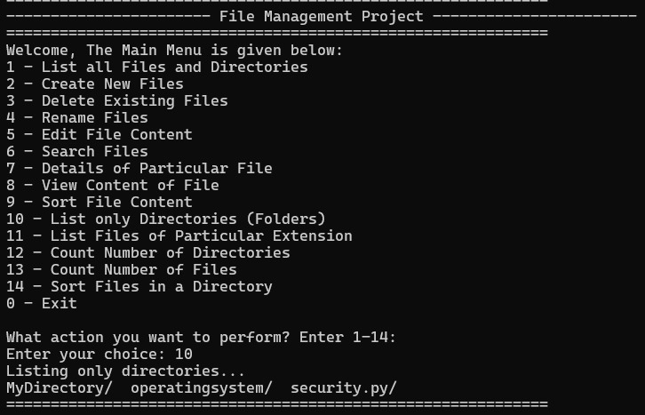
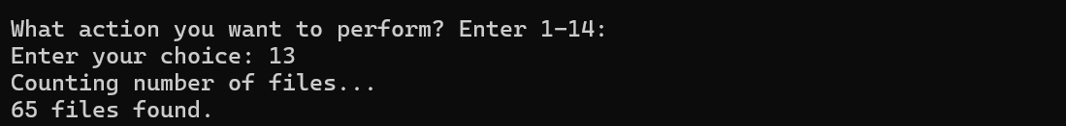
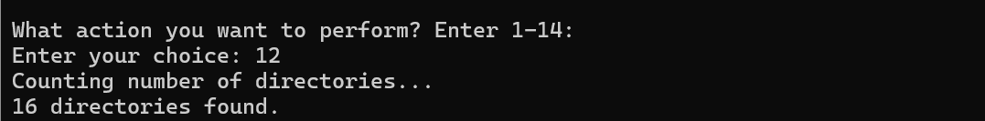
Results

Slide 13
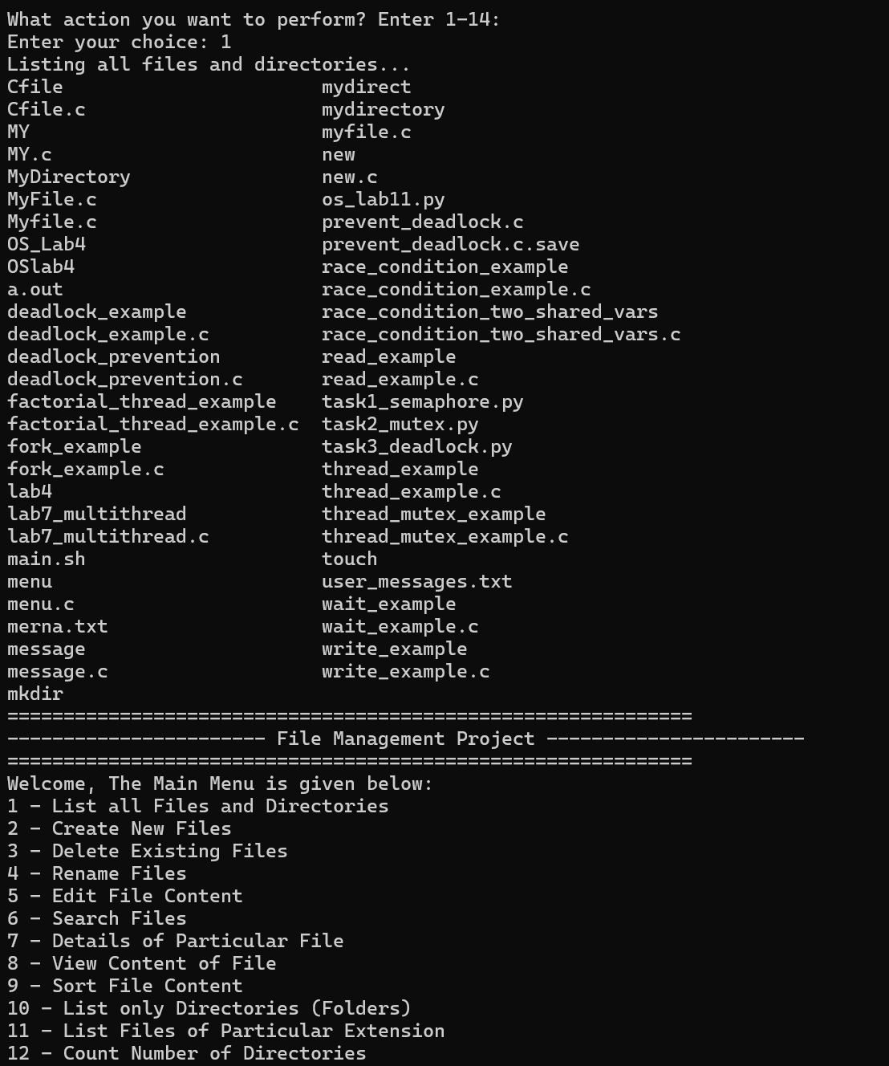
Results

Slide 14
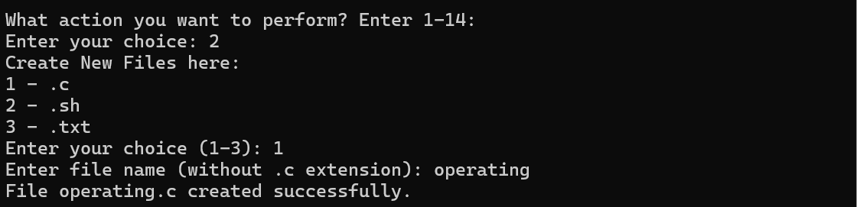
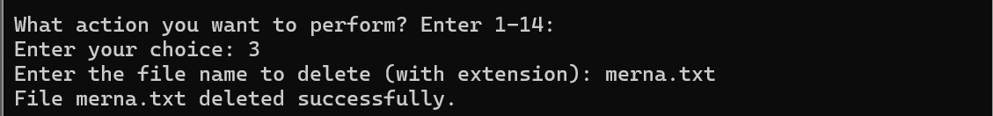
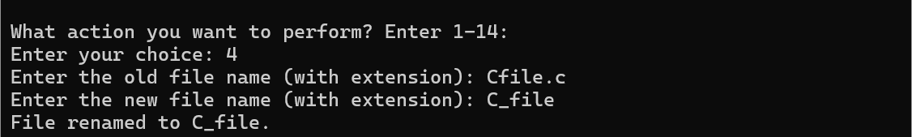
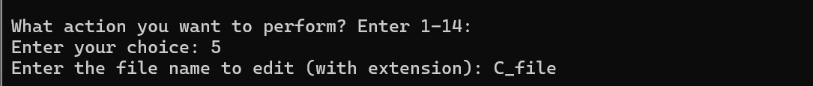
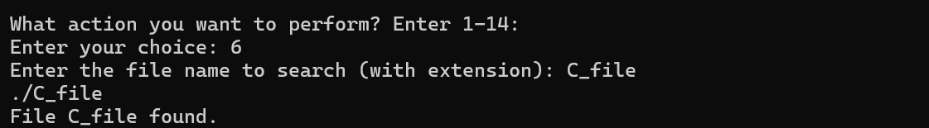
Results

Slide 15
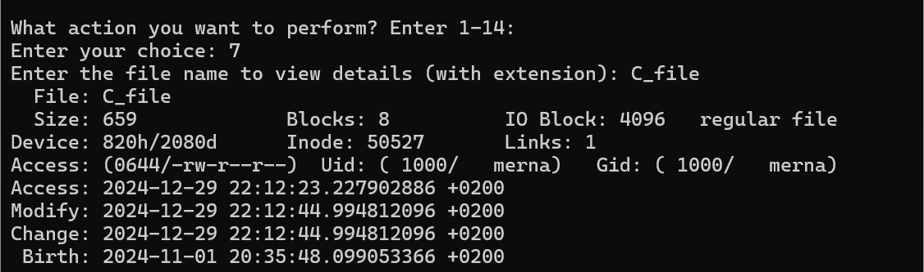
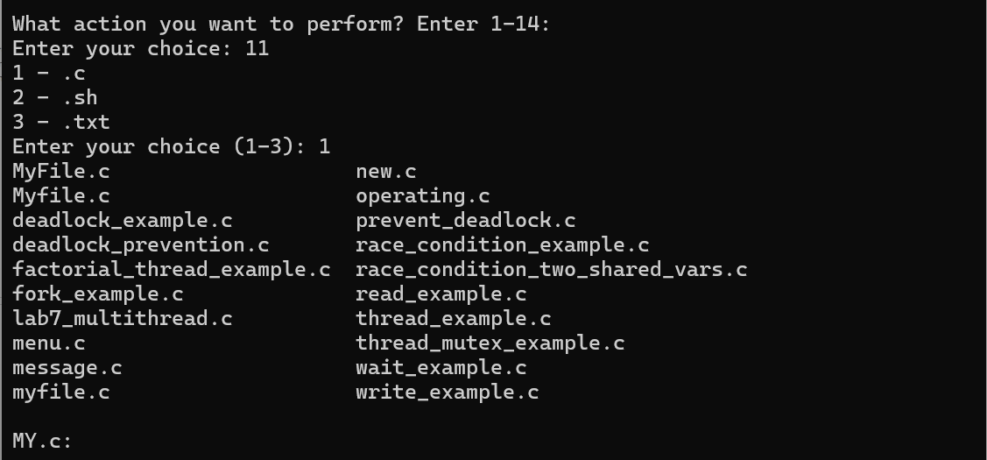
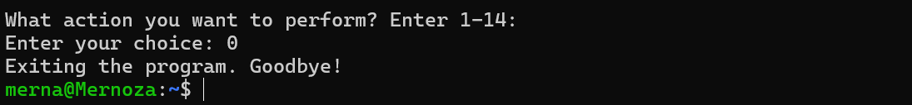
Results

Slide 16
Conclusion
The project achieved its objective of providing a comprehensive file management system.
The integration of menu-driven operations and automation enhances.
productivity and minimizes errors.

Slide 17
Thank you Any Questions

